Slide 1
Big Data Analytics
Assignment - 3
Abhishek Agarwal - 2016126
Kaustav Vats - 2016048

Slide 2
Learnings
In our assignment, we have used tweepy and Apache Kafka to extract tweets from a stream. Tweepy is a python library, it provides various API calls which can be used to do anything on twitter data programmatically. It can be used to send and receive tweets, access any twitter user data, follow/unfollow, post, and lot more. For our assignment, we mainly focused on extracting tweets in real-time with keywords/hashtags related to COVID-19.
Kafka is a fast messaging system that enables the communication between producer and consumer using message-based topics. this messaging system is highly available and resilient to node failure with automatic recovery. This allows for making a real-time streaming application. It's an ideal system for large scale data systems. We also learned about its architecture and also about each of its components.
We learned about the reservoir sampling algorithm, which provides a way of randomly choosing some samples from the item list with a huge size.

Slide 3
Timing for various steps in the Assignment
The time intervals were: 10 minutes, 20 minutes, 30 minutes, 40 minutes.
Number of times the experiment had to be done: 15
Total experiment time: 10 hours (600 minutes)
Total time spent in understanding, coding and obtaining the expected results was about 25 hours
Hashtags used - #Covid-19, #Coronavirus and #Covid19
File Structure-
KafkaProducer.py: Extracts tweets using tweepy library and adds them to a stream using kafkaProducer api.
KafkaConsumer.py: Reads tweets from the stream and applies reservoir sampling algorithm and dumps data in a pickle file.
AMS.py: This programs reads the dumped data and applies ams algorithm to compute second moment.
A3.py: Contains tweets extraction code using tweepy library and dumps the data in a pickle file.
Data Folder & Graphs Folders: Contains all dumped data and graphs for all time intervals.

Slide 4
Challenges
Kafka installation on windows. Not much a big challenge, but was difficult to find a simple installation blog for windows.
Understanding the usage of Kafka for this assignment. Took some time to set right parameters for the real-time stream. We also noted that, if parameters are not mentioned properly then it’s possible that you’re getting previously store data from the stream instead of real-time data.
Collection of tweets was a big task, as it requires good network connectivity for long duration. To achieve that we avoided using internet for any other purpose as, it might affect data transmission rate.

Slide 5
Working
We have used a Tweepy and Kafka in python to stream the data
There is one producer instance and one consumer instance
Both the codes are run parallely and consumer keeps collecting the stream of tweets generated by the producer
For each tweet, we extract the user id from the tweet
There is a time counter which keeps a track of time lapsed
A dictionary maintains the count of the number of tweets done per user. The size of this dictionary does not exceed 10,000 at any point.
Once the dictionary size is 10,000, then for a new tweet that comes, we generate a random number between 1 and 10,000. The uid present at that index in the ordered dictionary is popped and updated with this new user id and the corresponding value is 1.
Once the time interval is over, the respective dictionary containing the user id and number of tweets is pickled and stored.
We also store the total number of tweets received in that particular interval (Window size).

Slide 6
Computing the Surprise Number
Applying the AMS algorithm to compute the expected surprise number:
Surprise number is given by: E(n * (2 * X.value - 1)
Thus in our case this is calculated by:
(n * ∑(2 * values - 1))/(number of distinct users)
where n = number of tweets streamed in that interval
summation over values is done by taking the values from the stored dictionary
Number of distinct users is computed by taking the length of dictionary

Slide 7
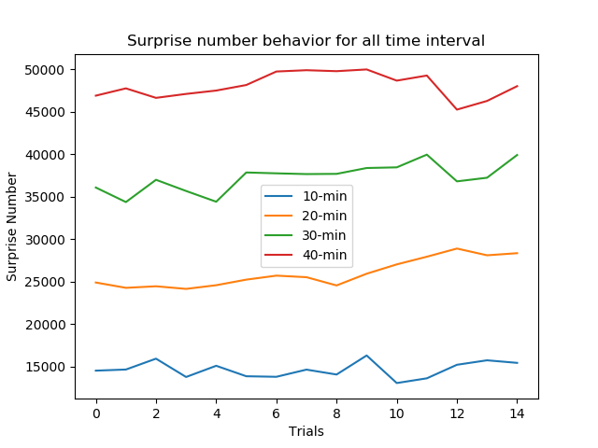
Results

Slide 8
Inferences
The magnitude of surprise number keeps increasing as we increase the streaming interval.
This progressive increase can be attributed to the fast increment of Numerator i.e. the total number of tweets streamed in that interval. However, the denominator remains almost the same i.e. 10k.

Slide 9
References
https://stackoverflow.com/questions/36114068/implementing-the-alon-matias-szegedy-algorithm-for-the-second-moment-stream-appr
https://towardsdatascience.com/how-to-scrape-tweets-from-twitter-59287e20f0f1
Tweepy API examples - https://dzone.com/articles/using-twitter-with-python-and-tweepy

